Slide 1
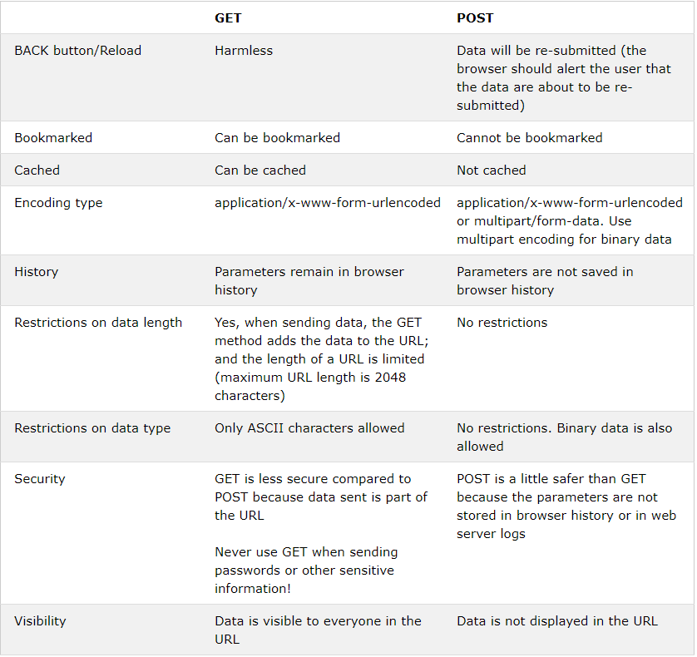
Lab 02

Slide 2
Lab 02
PHP echo and print Statements
echo and print are more or less the same. They are both used to output data to the screen.
The differences are small: echo has no return value while print has a return value of 1 so it can be used in expressions. echo can take multiple parameters (although such usage is rare) while print can take one argument. echo is marginally faster than print.

Slide 3
Lab 04
$GLOBALS is used to access global variables from any part of your PHP script, including from within a function or method.
Format for this keyword is $GLOBALS [<variable name>]
<variable name> is the name of the variable you want to access.

Slide 4
Lab 04
So far as I know, a public static field is basically a global given that it can be called from anywhere with the exception that it does not clog the namespace.
One reason to use
The only time I personally use 'global' variables in my code are in the form of public static fields that are immutable. In this case there is no need to worry about the value being screwed around by other parts of the program and of course its a lot nicer than having a dozen variables with the same permanent values in each class.

Slide 5
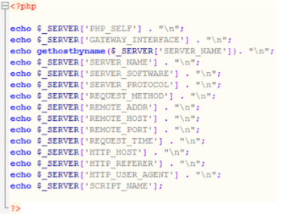
Lab 04
$_SERVER holds information about headers, paths, and script locations. Figure 2 below shows an example of how to use some of the elements in $_SERVER.

Slide 6
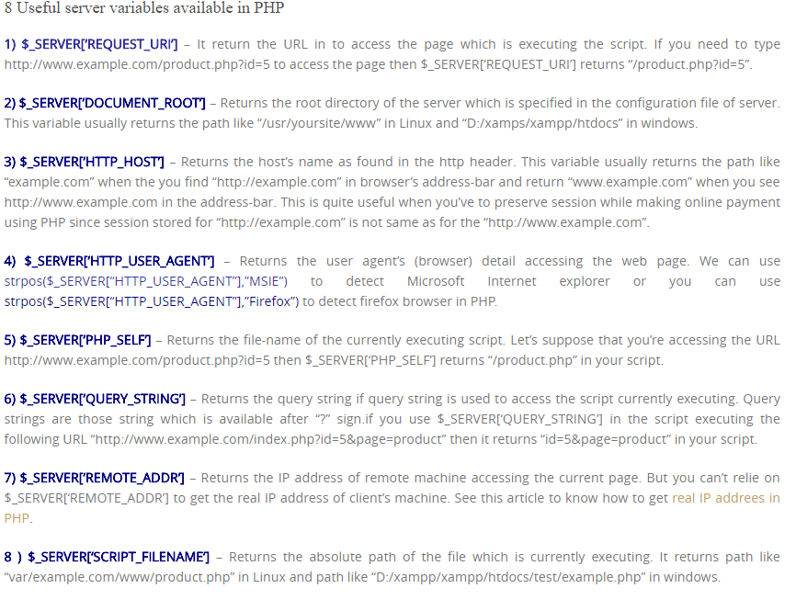
Lab 04

Slide 7
Lab 04
$_ENV PHP environment variables allow your scripts to glean certain types of data dynamically from the server.
This supports script flexibility in a potentially changing server environment. For example, the SITE_HTMLROOT variable provided by (mt) Media Temple will automatically provide the correct path to your document root on any Grid server, without necessitating any changes in your script.
(mt) Media Temple provides several dozen variables like this for your convenience.

Slide 8
Lab 04
On the Grid, it is particularly helpful to use a few select environment variables, for three reasons.
First, if you ever decide to re-use a script on a different domain on the Grid, you won't have to change all your variables.
Second, the variables are often more convenient than the long path and server names used for the Grid architecture.
Third, the Grid load-balancing occasionally requires sites and databases to be shifted to different physical machines, which can change your environment. This is not a common occurrence, but it is an essential part of Grid functionality.

Slide 9
Lab 05
Each file uploaded by the user if stored in an array variable containing its binary and file properties.
These properties include file name, file size, file type, and more.
Note that uploaded files reside in the application temporary folder, having a temporary name.
They are moved into targeted folder using keyword: move_uploaded_file.
Format of the array: $_FILES [“<HTML input tag name>”] [“<property>”] [<index number>]
Example: $_FILES ["FileToUpload"] ["name"] [0]

Slide 10
Lab 06
By default, when an error occurs, error message with filename, line number and a message describing the error is sent to the browser.
Alternatively, you can also define your own error handling rules, as well as modify the way the errors can be logged.
This allows you to change and enhance error reporting to suit your needs. In additions, you can send messages directly to other machines, to an email (or email to pager gateway!), to system logs, etc.,
so you can selectively log and monitor the most important parts of your applications and websites.

Slide 11
Lab 06
Creating a custom error handler involves 3 parts, i.e. custom function, handler registration, and error trigger.
set_error_handler ( <error_function>, [<error_level>] );
Why do you think your program has errors?
User input incorrect eg nothing inputed, to long, to short.

Slide 12
Lab 07
Sessions
By default, session variables last until the user closes the web browser. They hold information about one single user, and are available to all pages in one application.
A session in PHP is started with function: session_start ( );
This function keyword must be placed before any HTML tag being transmitted to the web browser. It is highly recommended to place it at the start of PHP page.
Session variables are set and retrieved with the PHP global variable: $_SESSION [ <variable name> ]. This keyword may appear anywhere within a PHP page, after session_start ( );

Slide 13
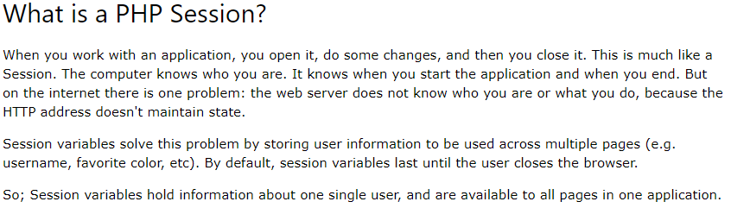
Lab 07

Slide 14
Lab 07
Cookies
Unlike session variables which are stored at the web server, a cookie variable (or a cookie in short) is stored at the user’s computer, and therefore often used to identify the user.
A cookie is generally in form of a small file. Each time the same computer requests a page with a browser, the cookies are sent along.
Cookies are set using keyword: setcookies ( <variable name>, <value>, <expiry> ). Values are retrieved using keyword: $_COOKIE [ <variable name> ].
There is no requirement to start a cookie function prior to using this keyword.

Slide 15
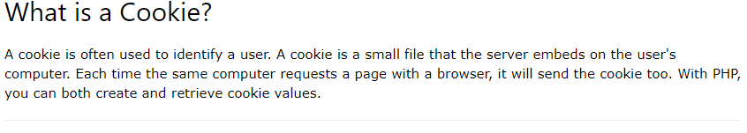
Lab

Slide 16
Lab 08
There are 2 common methods to connect to MySQL database in PHP application, i.e. MySQLi and PDO (PHP Data Objects).
Versions of PHP used the MySQL extension. However, this extension was deprecated in 2012.
Both MySQLi and PDO have their advantages. PDO will work on 12 different database systems, where as MySQLi will only work with MySQL databases.
If you have to switch your project to use another database, PDO makes the process easy. You only have to change the connection string and a few queries.
With MySQLi, you will need to rewrite the entire code, including queries.
Both are object-oriented, but MySQLi also offers a procedural API.
Both also support Prepared Statements, which are very important for web application security as they protect from SQL injection.

Slide 17
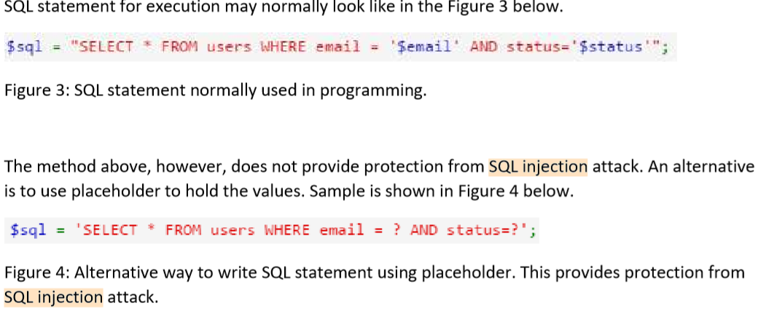
Lab 08

Slide 18
Lab 08
SELECT INSERT UPDATE DELETE
FORMAT
ROW COUNT

Slide 19
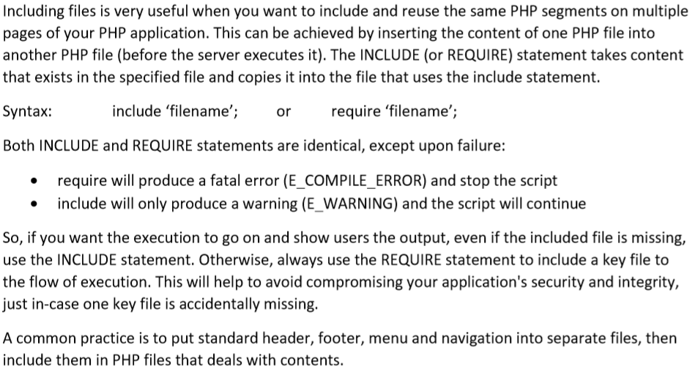
Lab 09

Slide 20
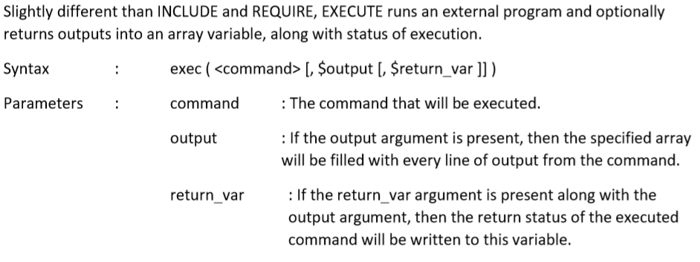
Lab 09

Slide 21
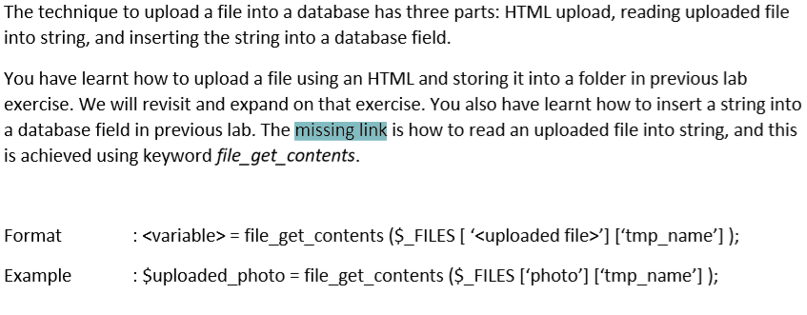
Lab 10

Slide 22
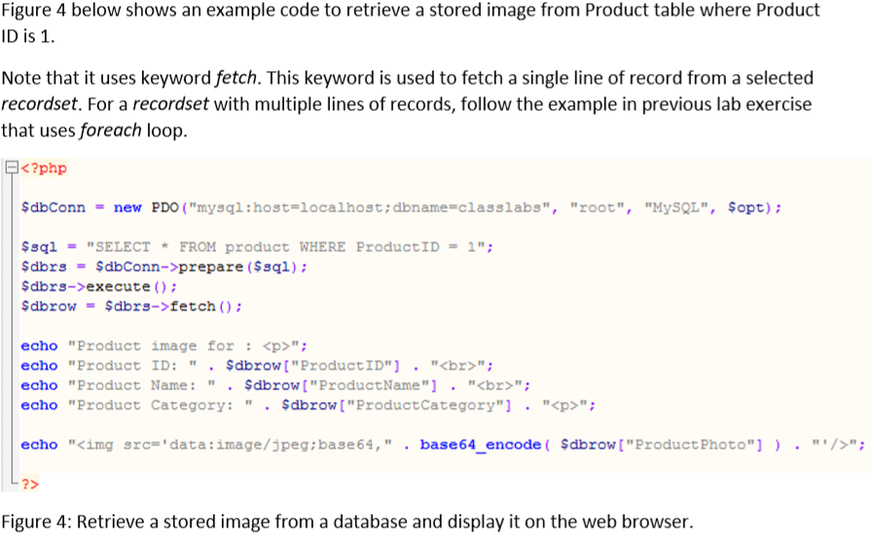
Lab 10

Slide 23
Lab 11
There are two common methods to send an email message in PHP, i.e. using the server’s built-in mail server and using an external mail server.
In this exercise, we will look at the implementation of these methods using a different technique in each method.

Slide 24
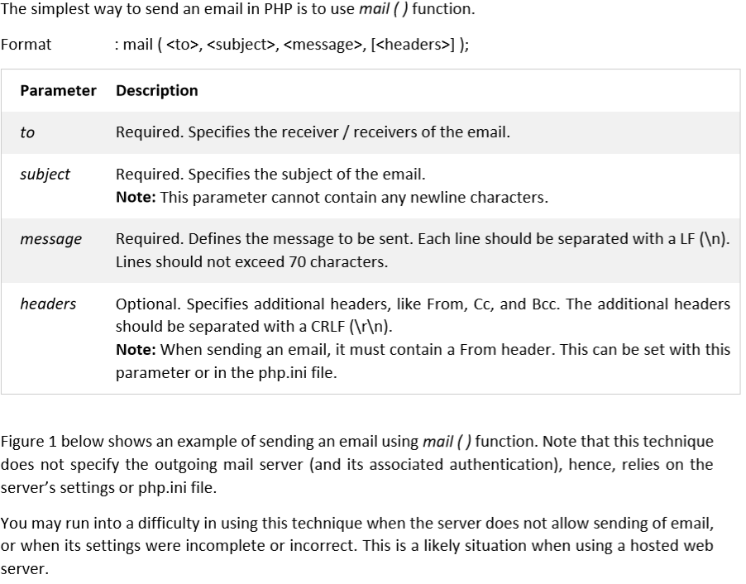
Lab 11

Slide 25
Lab 12

Slide 26
Lab

Slide 27
Lab

